Slide 1

GYMNASIUM
G Y M P L A C E
Our Team:
CHARAN KUMAR NAIDU
JHALAK JAIN
ADISH JAIN
ADITYA BONDRE
Mentor:
S URAMYA BISWAS

Slide 2


TABLE OF CONTENT
G Y M P L A C E
Project statement
Frontend and Backend Technologies
User Authentication and Registration
Gym Slot Scheduling Interface
Slot availability Management
Slot Booking Information Management
FeedBack Management Admin Dashboard

Slide 3
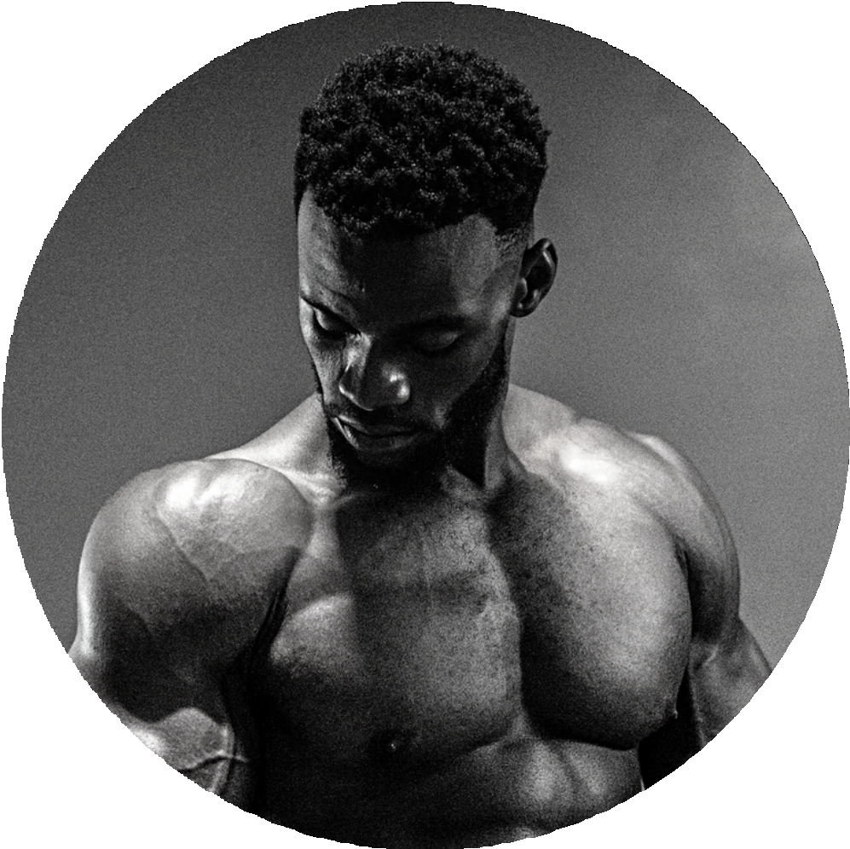
PROJECT STATEMENT
Our project aims to develop a user-friendly web application that facilitates the Gym Management Software is a gym and health club membership management system. You can keep records on your members, their memberships, and have quick and easy communication between you and your members. Gym Management also includes a booking system, cancellation system , feedback system and has a range of reports that help in the management of your club
G Y M P L A C E
OUTCOMES
Our Gym Management Software is a complete gym and recreation facility system program which looks after all of your members, memberships and activities. It is designed for gyms, recreation center, and health clubs.

Slide 4




FRONTEND TECHNOLOGIES
G Y M P L A C E
JSP
CSS
JAVASCRIPT
BACKEND TECHNOLOGIES
Java
Spring Boot
MySQL

Slide 5

USER AUTHENTICATION AND REGISTRATION
G Y M P L A C E
User authentication and registration involve implementing functionality for new users to create accounts, developing a login mechanism for accessing these accounts, and integrating features for email verification and password reset to ensure security and user convenience.
GYM place aims to train muscles and stamina

Slide 6

GYM SLOT SCHEDULING INTERFACE
G Y M P L A C E
It involves to design a database schema to store gym slot availability information, including tables for slots, availability times, and bookings.
Develop an interface for gym staff to set and update slot availability, and implement backend functionality to manage these updates, ensuring accurate and real-time availability information.

Slide 7

SLOT AVAILABILITY MANAGEMENT
G Y M P L A C E
We design and develop an interface for slot scheduling that allows users to select their preferred time slots. Implement functionality for users to choose and book these slots, and integrate the scheduling interface with the backend to store and manage the time slot details accurately.

Slide 8





SLOT BOOKING INFORMATION MANAGEMENT
G Y M P L A C E
We Design a database schema to store slot details, including tables for slots, schedules, and bookings. Implement backend functionality to manage slot scheduling and prevent conflicts.
Develop an interface for both organizers and customers to view and manage slot availability and bookings effectively.

Slide 9

CUSTOMER FEEDBACK INFORMATION MANAGEMENT
G Y M P L A C E
We design a secure database schema for storing customer information, including tables for personal details, contact information, and account settings.
Develop functionality that allows customers to provide and update their information easily.
Implement backend logic to securely access and manage this customer information, ensuring data protection and privacy
Exercising muscles at the GYM is the right choice with the help of the GYM Guide.

Slide 10



ADMIN DASHBOARD
G Y M P L A C E
The admin dashboard design focuses on intuitive user management functionalities, enabling admins to add, edit, and delete users effortlessly. It incorporates modules for managing slots, and customer information efficiently. User-friendly interfaces facilitate seamless navigation and operation, ensuring administrators can oversee and manage all aspects of the system effortlessly. The layout prioritizes clarity and accessibility, enhancing the overall user experience for administrators.

Slide 11


G Y M P L A C E
THANK YOU

